Slide 1
Cat Rock Cafe
Forum Page
Eric Grant

Slide 2
Purpose
Cat Rock Cafe is a fictional cat cafe.
The forum page is for patrons to talk about their favorite cats.

Slide 3
Database Tables
Users
Username
Password
First name
Last name
Zip
Email
Phone
Addresses
Zip
Street
State
City
Topics
Id
Title
Text
User
Time
Posts
Id
Topic_Id
Text
User
Time

Slide 4
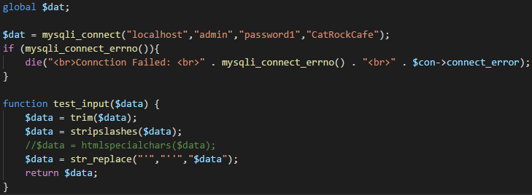
Connect to Database
user
password

Slide 5
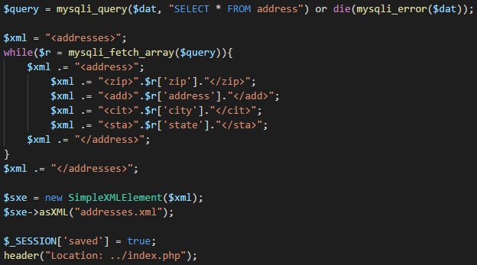
Save to XML

Slide 6
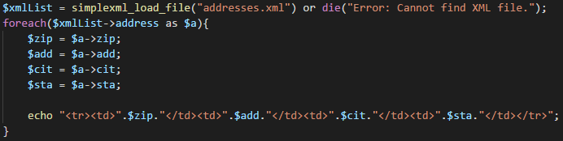
Load XML

Slide 7
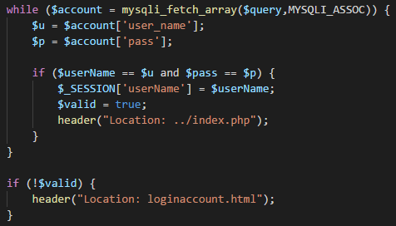
Login

Slide 8
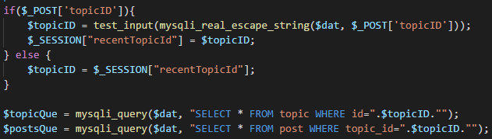
Forum Page

Slide 9
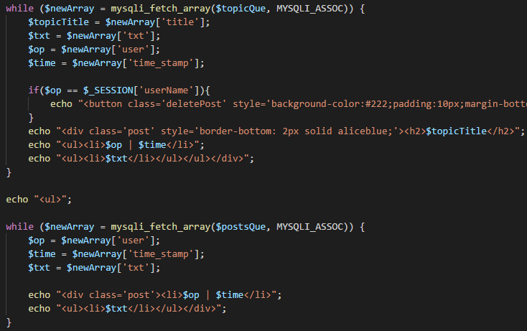

Slide 10
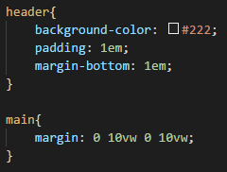
Mobile Design
Centered content
vw
vh
Em
Big buttons

Slide 11
What I Learned
How to manage my own database
MYPHP Admin
Database integration
User accounts

Slide 12
Questions?

